Slide 1
CSP554 Big Data Technologies
Module 07
Spark SQL (DataFrames)

Slide 2
What is Apache Spark?
Apache Spark is a unified computing engine and a set of libraries for parallel data processing on computer clusters
Spark is the most actively developed open source engine for this task; making it the de facto tool for any developer or data scientist interested in big data.
Spark supports multiple widely used programming languages (Python, Java, Scala and R), includes libraries for diverse tasks ranging from SQL to streaming and machine learning

Slide 3
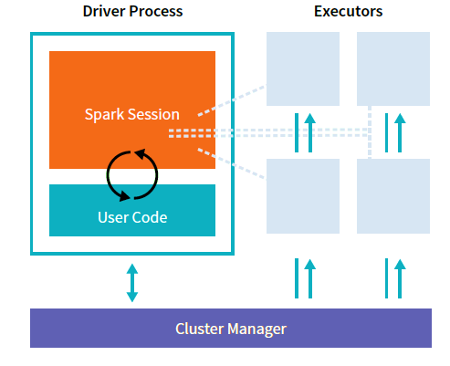
Spark’s Basic Architecture
Spark applications consist of a driver process and a set of executor processes
The driver process is responsible for distributing our program’s commands across the executors in order to complete our task.
The executors are responsible for actually executing the work that the driver assigns them
The cluster manager (YARN) controls physical (or virtual) machines and allocates resources to Spark Applications

Slide 4
Spark Data Abstractions
Spark has several core abstractions
Datasets
DataFrames
SQL Tables
Resilient Distributed Datasets (RDDs)
These abstractions all represent distributed collections of data however they have different interfaces for working with that data
The easiest and most efficient are DataFrames and SQL Tables

Slide 5
Spark Structured APIs
A tool for manipulating all sorts of data, from unstructured log files to semi-structured CSV files and highly structured Parquet files
Refers to three core types of distributed collection APIs:
Datasets
DataFrames
SQL (like) tables
The majority of the Structured APIs apply to both batch and streaming computation.
This means that when you work with the Structured APIs, it should be simple to migrate from batch to streaming (or vice versa) with little effort

Slide 6
DataFrames: A Quick Overview
A DataFrame is the most common Structured API and simply represents a table of data with rows and columns
The list of columns and the types in those columns are the DataFrame schema
A simple analogy would be a spreadsheet with named columns.
The fundamental difference is that while spreadsheet data sits on one computer in one specific location, a Spark DataFrame represents data that can span thousands of computers

Slide 7
DataFrame
A DataFrame is the most common Structured API and simply represents a table of data with rows and columns
The list of columns and the types in those columns the schema
A simple analogy would be a spreadsheet with named columns
The fundamental difference is that while a spreadsheet sits on one computer in one specific location, a Spark DataFrame can span thousands of computers
Each record in a DataFrame must be of type Row
The DataFrame itself can be considered as contained an Array where each entry is of type Row

Slide 8
Partitions
In order to allow every executor to perform work in parallel, Spark breaks up the data into chunks, called partitions
A partition is a collection of DataFrame or DataSet rows that sit on one physical (or virtual) machine in our cluster
A DataFrame’s partitions represent how the data is distributed across a cluster of machines during execution
If you have one partition, Spark will only have a parallelism of one even if you have thousands of executors.
If you have many partitions, but only one executor Spark will still only have a parallelism of one because there is only one computation resource

Slide 9
DataFrames and Datasets
DataFrames and Datasets are (distributed) table-like collections with well-defined rows and columns
Each row must have the same number of columns as all the other rows (although you can use null to specify the absence of a value).
Each column has type information that must be consistent for every row in the collection
DataFrames and Datasets represent immutable, lazily evaluated plans that specify what operations to apply to data residing at a location to generate some output
When we perform an action on a DataFrame, we instruct Spark to perform the actual transformations and return the result
These represent plans of how to manipulate rows and columns to compute the user’s desired result.

Slide 10
DataFrames Versus Datasets
Within the Structured APIs, there are two more APIs, the “untyped” DataFrames and the “typed” Datasets
To say that DataFrames are untyped is slightly inaccurate; they have types, but Spark maintains them completely and only checks whether those types line up to those specified in the schema at runtime
Datasets, on the other hand, check whether types conform to the specification at compile time
Datasets are only available to Java Virtual Machine (JVM)–based languages (Scala and Java)
For the most part, you’re likely to work with DataFrames.
DataFrames are simply Datasets of Type Row
That is, each record in a DataFrame is an instance of type Row
The “Row” type is Spark’s internal representation of its optimized in-memory format for computation

Slide 11
DataFrame Performance
DataFrames can be significantly faster than RDDs
And they perform the same, regardless of language

Slide 12
Schemas
Schemas consist of name and type information for each column of a DataFrame
You can define schemas manually or have Spark infer the schema from a data source as it is read in to a DataFrame

Slide 13
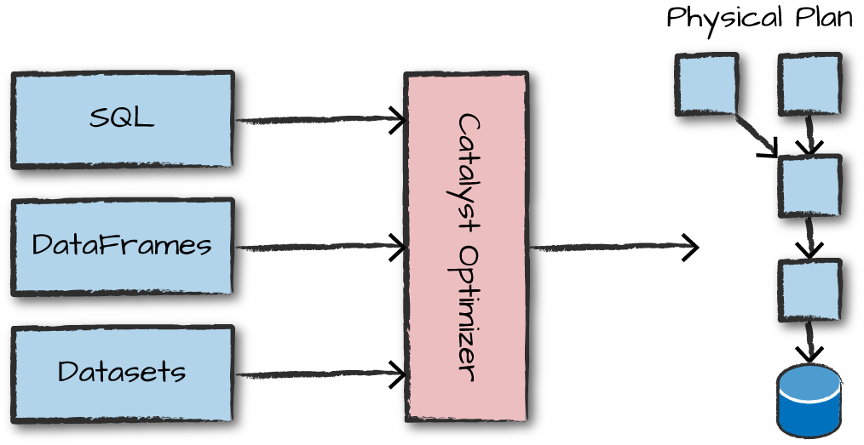
Overview of Structured API Execution
Write DataFrame/Dataset/SQL Code.
If valid code, Spark converts this to a Logical Plan
Spark transforms this Logical Plan to a Physical Plan, checking for optimizations along the way
Spark then executes this Physical Plan (RDD manipulations) on the cluster
Code is submitted to Spark either through the console or via a submitted job. This code then passes through the Catalyst Optimizer, which decides how the code should be executed and lays out a plan for doing so before, finally, the code is run and the result is returned to the user

Slide 14
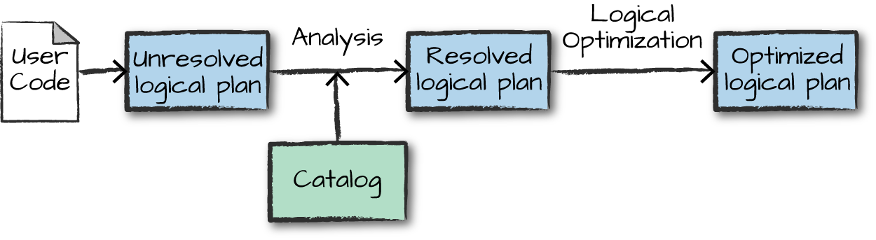
Structured API Execution Details Logical Plan
This logical plan represents a set of abstract transformations to convert the user’s set of expressions into the most optimized version
It does this by converting user code into an unresolved logical plan. This plan is unresolved because although your code might be valid, the tables or columns that it refers to might or might not exist.
Spark uses the catalog, a repository of all table and DataFrame information, to resolve columns and tables in the analyzer.
The result is passed through the Catalyst Optimizer, a collection of rules that attempt to optimize the logical plan by pushing down predicates or selections.

Slide 15
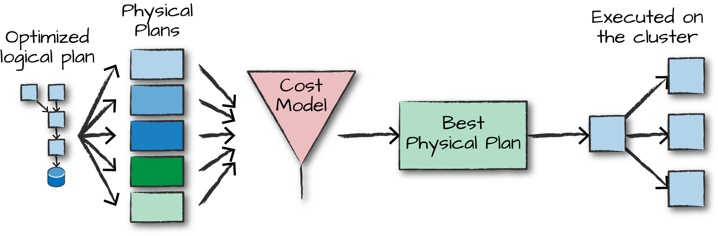
Structured API Execution Details Physical Plan
The physical plan, often called a Spark plan, specifies how the logical plan will execute on the cluster by generating different physical execution strategies and comparing them through a cost model,
An example of the cost comparison might be choosing how to perform a given join by looking at the physical attributes of a given table (how big the table is or how big its partitions are)
Physical planning results in a series of RDDs and transformations
Spark then runs all of this code on the Hadoop cluster

Slide 16
An End to End Example
Here will will work an example step by step using some flight data available here from the United States Bureau of Transportation statistics
Here is a same of the file including the header row with column labels and a few data rows
DEST_COUNTRY_NAME,ORIGIN_COUNTRY_NAME,count
United States,Romania,15
United States,Croatia,1
United States,Ireland,344

Slide 17
An End to End Example
Spark includes the ability to read and write from a large number of data sources
In order to read this data in, we will use a DataFrameReader that is associated with our SparkSession
In doing so, we will specify the file format as well as any options we want to specify
In our case, we want to do something called schema inference, we want Spark to take the best guess at what the schema of our DataFrame should be.
We also want to specify that the first row is the header in the file, we’ll specify that as an option too.
To get this information Spark will read in a little bit of the data and then attempt to parse the types in those rows according to the types available in Spark
flightData2015 = spark\
.read\
.option("inferSchema", "true")\
.option("header", "true")\
.csv(”hdfs:///mnt/defg/flight-data/csv/2015-summary.csv")

Slide 18
An End to End Example
Each of these DataFrames have a set of columns with an unspecified number of rows
The reason the number of rows is “unspecified” is because reading data is a transformation, and is therefore a lazy operation
Spark only peeked at a couple of rows of data to try to guess what types each column should be
If we perform the take action on the DataFrame, we will be able to see the results
flightData2015.take(3)
Array([United States,Romania,15], [United States,Croatia...

Slide 19
An End to End Example
Let’s specify some more transformations!
Now we will sort our data according to the count column which is an integer type
Nothing happens to the data when we call sort because it’s just a transformation
However, Spark is building up a plan for how it will execute this across the cluster
Now, just like we did before, we can specify an action in order to kick off this plan
However before doing that, we’re going to set a configuration
By default, when we perform a shuffle Spark will output two hundred shuffle partitions
We will set this value to five in order to reduce the number of the output partitions from the shuffle
spark.conf.set("spark.sql.shuffle.partitions", "5")
flightData2015.sort("count").take(2)
... Array([United States,Singapore,1], [Moldova,United States,1])

Slide 20
An End to End Example
This operation is illustrated in the following image
In addition to the logical transformations, we include the physical partition count as well

Slide 21
Spark SQL
The Hive project was instrumental in providing the pattern of SQL-like access to unstructured data in HDFS…
But performance and user experience clearly fell well short of database systems
The batch nature of MapReduce, which is the processing engine behind Hive, was not suited to interactive queries or real-time applications
Spark SQL provides an SQL abstraction to its RDD-based storage, scheduling, and execution model
Many key characteristics of core Spark are inherited by Spark SQL
Including lazy evaluation and mid-query fault tolerance
Moreover, Spark SQL can be used in conjunction with the Spark core API within a single application.

Slide 22
Spark SQL
One use of Spark SQL is to execute SQL queries written using either a basic SQL syntax or HQL
Spark SQL can also be used to read data from an existing Hive files
You interact with the SQL interface using the command line or via JDBC/ODBC
The whitepaper titled “Spark SQL: Relational Data Processing in Spark” is recommended further reading

Slide 23
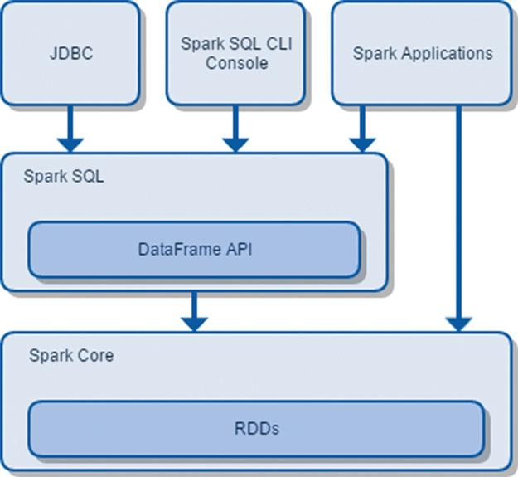
Spark SQL Architecture

Slide 24
DataFrames and SQL
Spark SQL allows you to register any DataFrame as a table and query it using pure SQL
There is no performance difference between writing SQL queries or writing DataFrame code
They both “compile” to the same underlying plan
Any DataFrame can be made into a table or view with one simple method call
flightData2015.createOrReplaceTempView("flight_data_2015")
Now we can query our data in SQL
To execute a SQL query, we’ll use the spark.sql() function that returns a new DataFrame
While this may seem a bit circular in logic that a SQL query against a DataFrame returns another DataFrame, it’s actually quite powerful
As a user, you can specify transformations in the manner most convenient to you at any given point in time and not have to trade any efficiency to do so

Slide 25
DataFrames and SQL
sqlWay = spark.sql("""
SELECT DEST_COUNTRY_NAME, count(1)
FROM flight_data_2015
GROUP BY DEST_COUNTRY_NAME
""")
dataFrameWay = flightData2015\
.groupBy("DEST_COUNTRY_NAME")\
.count()

Slide 26
DataFrames and SQL
maxSql = spark.sql("""
SELECT DEST_COUNTRY_NAME, sum(count) as destination_total
FROM flight_data_2015
GROUP BY DEST_COUNTRY_NAME
ORDER BY sum(count) DESC
LIMIT 5
""")
maxSql.collect()
from pyspark.sql.functions import desc
flightData2015\
.groupBy("DEST_COUNTRY_NAME")\
.sum("count")\
.withColumnRenamed("sum(count)", "destination_total")\
.sort(desc("destination_total"))\
.limit(5)\
.collect()

Slide 27
Using Spark SQL (DataFrames)
Python API docs
https://spark.apache.org/docs/2.4.3/api/python/index.html
Use ‘Quick Search’ to find the operation for which you are looking
Or see “Spark – Python API – SQL & DataFrames” on the blackboard in the “Free Books and Chapters” section

Slide 28
Using Spark SQL (DataFrames)
pyspark.sql.SparkSession
Main entry point for DataFrame and SQL functionality
A SparkSession can be used to…
Create DataFrame
Execute SQL over tables
Cache tables

Slide 29
Using Spark SQL (DataFrames)
pyspark.sql.DataFrameReader
Interface used to load a DataFrame from external storage systems Use SparkSession.read() to access this
pyspark.sql.DataFrameWriter
Interface used to write a DataFrame to external storage system
Use DataFrame.write() to access this.

Slide 30
Using Spark SQL (DataFrames)
pyspark.sql.DataFrame
A distributed collection of data grouped into named columns
A DataFrame is equivalent to a relational table in Spark SQL
Can register a DataFrame as table
pyspark.sql.Row
A row of data in a DataFrame
pyspark.sql.StructType
Defines the schema od (each Row in) a DataFrame
pyspark.sql.StructField
Defines the name and type of a filed in (each Row in) a DataFrame
pyspark.sql.types
List of data types available for each StructField

Slide 31
SparkContext and SparkSession
SparkContext was the main entry point for an application using the Spark Core API (that is work with RDDs)
In pyspark an instance of SparkContext is available and called ‘sc’
SparkSession is the main entry point for Spark SQL (and Spark DataFrames)
In pyspark an instance of SparkSession is available and called ‘spark’

Slide 32
DataFrame API
In a previous lecture, you learned how to manipulate RDDs
This is important because RDDs represent a low-level, direct way of manipulating data in Spark and the core of Spark runtime
Spark 1.3 introduced the DataFrame API for handling structured, distributed data in a table-like representation with named columns and declared column types

Slide 33
DataFrame API
A DataFrame is an RDD that has a schema
You can think of it as a relational database table, in that each column has a name and a known type
The power of DataFrames comes from the fact that, when you create a DataFrame from a structured dataset…
Spark is able to infer a schema by making a pass over the entire dataset that’s being loaded
When calculating the execution plan, Spark can use the schema and do better computation optimizations
Alternatively you can programmatically associate a schema with a DataFrame

Slide 34
DataFrame API
DataFrames can be constructed from a wide range of sources including…
An existing RDD
A JSON file
A text file, Parquet file, or ORC file
A table in Hive
An external database

Slide 35
DataFrame API
As an example, the following creates a DataFrame based on the content of a JSON file:
df = spark.read.json(”hdfs://examples/src/main/resources/people.json")
# Displays the content of the DataFrame to stdout
df.show()

Slide 36
DataFrame API
DataFrames translate SQL code and domain-specific language (DSL) expressions into optimized low-level RDD operations…
So that the same API can be used from any supported language (Scala, Java, Python, and R) for accessing any supported data source (files, databases, and so forth) in the same way and with comparable performance characteristics
Since their introduction, DataFrames have become one of the most important features in Spark and made Spark SQL the most actively developed Spark component
Since Spark 2.0, DataFrame is implemented as a special case of DataSet.

Slide 37
DataFrame API
SQL is so ubiquitous that the DataFrame API quickly met with acclamation by the wider Spark community
It allows you to attack a problem from a higher vantage point when compared to Spark Core transformations
The SQL-like syntax lets you express your intent in a more declarative fashion…
You describe what you want to achieve with a dataset, whereas with the Spark Core API you basically specify how to transform the data (to reshape it so you can come to a useful conclusion)
You may therefore think of Spark Core as a set of fundamental building blocks on which all other facilities are built
The code you write using the DataFrame API gets translated to a series of Spark Core transformations under the hood.

Slide 38
Schemas
A schema defines the column names and types of a DataFrame
We can either let a data source define the schema or we can define it explicitly ourselves
The function schema returns the schema associated with a DataFrame (whether Spark inferred or we provided the schema definition)
spark.read.format(“json”)\
.load(“hdfs:///user/hadoop/2015-summary.json”)\
.schema(…)

Slide 39
Schemas
Python will return
StructType(
List (
StructField(DEST_COUNTRY_NAME, StringType, true),
StructField(ORIGIN_COUNTRY_NAME, StringType, true),
StructField(count, LongType, true)
)
)
A schema is a StructType made up of a number of fields called StructFields
That provide a name, type, and a Boolean flag which specifies whether or not that column can contain missing or null values
Column Name Column Type Null Allowed?

Slide 40
Schemas
Here’s how to create, and enforce a specific schema on a DataFrame
If the types in the data (on read), do not match the schema then Spark will throw an error
from pyspark.sql.types import StructField, StructType, StringType, LongType
myManualSchema = StructType([
StructField(“DEST_COUNTRY_NAME”, StringType(), True),
StructField(“ORIGIN_COUNTRY_NAME”, StringType(), True),
StructField(“count”, LongType(), False)
])
df = spark.read.format(“json”)\
.schema(myManualSchema)\
.load(“/hdfs:///user/hadoop/2015-summary.json”)

Slide 41
Programmatically Specifying the Schema
The preferred method of defining a schema for your DataFrame objects is to explicitly supply this in your code
Creating a schema requires you to create a StructType object containing a collection of StructField object
Apply this schema to your DataFrame when it is created

Slide 42
Programmatically Specifying the Schema
class pyspark.sql.types.StructType(fields=None)
Struct type, consisting of a list of StructField.
This is the data type representing a Row.

Slide 43
Programmatically Specifying the Schema
class pyspark.sql.types.StructField(name, dataType, nullable=True)
A field in StructType.
Parameters:
name – string, name of the field.
dataType – DataType of the field.
nullable – boolean, whether the field can be null (None) or not.

Slide 44
Programmatically Specifying the Schema
# Construct the schema
fields = [StructField(‘name’, StringType(), True), StructField(‘age’, StringType(), True)]
schema = StructType(fields)
# Apply the schema to the RDD.
schemaPeople = spark.createDataFrame(people, schema)
# Register the DataFrame as a table.
schemaPeople.createOrReplaceTempView("people")
# SQL can be run over DataFrames that have been registered
# as a table.
results = spark.sql("SELECT name FROM people")

Slide 45
DataFrame Type Model
The data model for the DataFrame API is based on the Hive data model
Datatypes used with DataFrames map directly to their equivalents in Hive
This includes all of the common primitive types as well as the complex types

Slide 46
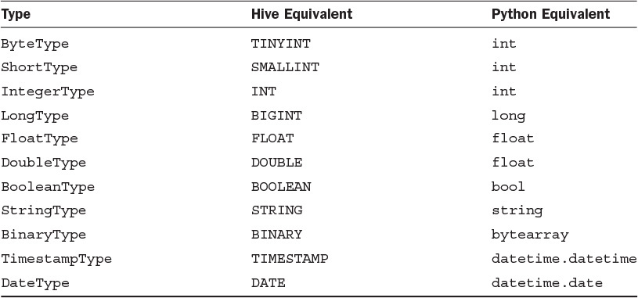
DataFrame Primitive Types

Slide 47
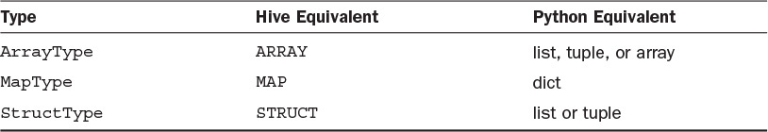
DataFrame Complex Types

Slide 48
Running SQL Queries on DataFrames
The sql() function of SparkSession enables applications to run SQL queries and returns the result as a DataFrame
SQL queries reference tables and not DataFrames…
So DataFrame provides a function to register itself as a table known to the SQL processor

Slide 49
DataFrame createOrReplaceTempView(tableName)
Register as a temporary table in the catalog.
The lifetime of the table is tied to that of the SparkSession used to create the associated DataFrame
someDataFrame.createOrReplaceTempView( "table1")

Slide 50
SparkSession sql(sqlQuery)
Returns a DataFrame representing the result of the given query
Returns: DataFrame
df1.createOrReplaceTempView(("table1")
df2 = spark.sql("SELECT field1 AS f1, field2 as f2 from table1")
df2.collect()
[Row(f1=1, f2=u'row1'), Row(f1=2, f2=u'row2'), Row(f1=3, f2=u'row3')]

Slide 51
Creating DataFrames
There are six core data sources from which you can create a DataFrame
CSV
JSON
Parquet
ORC
JDBC/ODBC
Plain text files
For testing purposes you can even create a DataFrame from a list programmatically
Spark also has many community developed data sources from which a DataFrame can be created
Cassandra
MongoDB
Many more

Slide 52
Creating DataFrames From a Python List
The simplest way to create a DataFrame is from a Python list of data: SparkSession.createDataFrame(data, schema=None)
simpleData = [
("James",34,"2006-01-01","true","M",3000.60),
("Michael",33,"1980-01-10","true","F",3300.80),
("Robert",37,"06-01-1992","false","M",5000.50)
]
columns = ["firstname","age","jobStartDate","isGraduated","gender","salary"]
df = spark.createDataFrame(data = simpleData, schema = columns)

Slide 53
Creating DataFrames From a Python List
The simplest way to create a DataFrame is from a Python list of data: SparkSession.createDataFrame(data, schema=None)
data2 = [("James","","Smith","36636","M",3000),
("Michael","Rose","","40288","M",4000),
("Robert","","Williams","42114","M",4000)
]
schema = StructType([ \
StructField("firstname",StringType(),True), \
StructField("middlename",StringType(),True), \
StructField("lastname",StringType(),True), \
StructField("id", StringType(), True), \
StructField("gender", StringType(), True), \
StructField("salary", IntegerType(), True) \
])
df = spark.createDataFrame(data=data2,schema=schema)

Slide 54
Creating DataFrames The core structure for reading external data
The foundation for reading external data into Spark is the DataFrameReader
We access a DataFrameReader from the SparkSession via the read attribute
spark.read
After we have a DataFrame reader, we specify several values:
The format (of the data to be read in, default is parquet)
The schema (if any, by which the data is described, default is none and Spark infers a schema)
The read mode (indicating how to handle malformed data, default is permissive)
A series of options
The format, options, and schema each return a DataFrameReader that can undergo further transformations
The general pattern for reading external data looks as follows
spark.format(…).option(“key1”, “value1”).option(”key2”, “value2”).schema(…).load(…)

Slide 55
Creating DataFrames The core structure for reading external data
As an example for reading in a csv file
spark. \
read.format(“csv”) \
.option(“mode”, “FAILFAST”) \
.option(“header”, True) \
.schema(someSchema) \
.load(“hdfs://user/hadoop/somefile.csv”)
But there are shorthand way that are generally used to read in data having common formats, which we will use going forward, for example:
someSchema = …
spark.read.csv(“hdfs:///path/to/file”, schema=someSchema, sep=‘:’)

Slide 56
Creating DataFrames from Files
Version 1.4 of Spark introduced a new interface used to load DataFrames from external storage systems
This interface is provided through the DataFrameReader class
The DataFrameReader interface is accessed using the SparkSession.read() function

Slide 57
SparkSession read()
Returns a DataFrameReader that can be used to read data in as a DataFrame.
Returns: DataFrameReader

Slide 58
DataFrameReader json(path, schema=None)
Loads a JSON file (one object per line) or an RDD of Strings storing JSON objects (one object per record) and returns the result as a :class`DataFrame`
JSON is a common, standard, human-readable serialization (or wire transfer) format that is often used in web service responses
Parameters:
path – string represents path to the JSON dataset, or RDD of Strings storing JSON objects.
schema – an optional StructType for the input schema
If the schema parameter is not specified, this function goes through the input once to determine the input schema.
Example
df1 = spark.read.json(‘hdfs:///user/CSP554prof/people.json')

Slide 59
DataFrameReader text(paths)
Loads a text file and returns a DataFrame with a single string column named “value”
Each line in the text file is a new row in the resulting DataFrame.
Parameters:
paths – string, or list of strings, for input path(s).
Example
df = spark.read.text('python/test_support/sql/text-test.txt')
df.collect()
[Row(value=u'hello'), Row(value=u'this')]

Slide 60
DataFrameReader Other File Types
parquet(*paths)
Loads a Parquet file, returning the result as a DataFrame
orc(path)
Loads an ORC file, returning the result as a DataFrame
Note: Currently ORC support is only available together with HiveContext
jdbc(…)
Construct a DataFrame representing the database table accessible via JDBC URL url named table and connection properties

Slide 61
Creating a DataFrame from a Hive Table
To load data from a Hive table into a Spark SQL Data-Frame, you will need a HiveContext to be created
HiveContext reads the Hive client configuration (hive-site.xml) to obtain connection details for the Hive metastore
This enables seamless access to Hive tables from a Spark application

Slide 62
Creating a DataFrame from a Hive Table
When working with Hive one must construct a HiveContext, which inherits from SparkSession, and adds support for finding tables in the MetaStore and writing queries using HQL.
# sc is an existing SparkContext.
from pyspark.sql import HiveContext
SparkSession = HiveContext(sc)
spark.sql("CREATE TABLE IF NOT EXISTS src (key INT, value STRING)")
spark.sql("LOAD DATA LOCAL INPATH ‘user/cs/kv1.txt' INTO TABLE src")
# Queries can be expressed in HiveQL.
results = spark.sql("FROM src SELECT key, value").collect()

Slide 63
DataFrame Operations/Transformations
DataFrames provide a domain-specific language for data manipulation in Scala, Java, Python and R
Here we include some basic examples of structured data processing using DataFrames…

Slide 64
Transformations
In Spark, the core data structures are immutable meaning they cannot be changed once created.
If you cannot change it, how are you supposed to use it?
In order to “change” a DataFrame you will have to instruct Spark how you would like to modify the DataFrame you have (the ”source”) into the one that you want (the “target”)
These instructions are called transformations.
Let’s perform a simple transformation to find all even numbers in our current DataFrame
targetDF = sourceDF.where("number % 2 = 0")
Note, this code returns no output, that’s because we only specified an abstract transformation and Spark will not act on transformations until we call an action

Slide 65
Transformation Types
There are two types of transformations…
Those that specify narrow dependencies
And those that specify wide dependencies

Slide 66
Narrow Transformations
Transformations consisting of narrow dependencies (we’ll call them narrow transformations) are those where each input partition will contribute to only one output partition
In the preceding code snippet our “where” statement specifies a narrow dependency
targetDF = sourceDF.where("number % 2 = 0")
Only one input partition contributes to at most one output partition
5
4
2
where("number % 2 = 0")
4
2
9
8
8

Slide 67
Wide Transformations
A wide dependency (or wide transformation) style transformation will have input partitions contributing to many output partitions
Examples include the join(), sort() and groupBy() transformations
targetDF = sourceDF.sort(sourceDF.number)
You will often hear this referred to as a shuffle where Spark will exchange partitions across the cluster
When we perform a shuffle, Spark will write the results to disk
1
2
sort(sourceDF.number)
5
4
2
4
5
1

Slide 68
Lazy Evaluation
Both the above Narrow Wide Transformation types are lazy in nature…
This means that until and unless any action is performed over these transformations their execution is delayed
Due to this delay the Spark execution engine gets a whole view of all the chained transformations and ample time to optimize your query
Spark, by waiting until the last minute to execute the code, will compile your raw, DataFrame transformations, to an efficient physical plan that will run as efficiently as possible across the cluster
This provides immense benefits to the end user because Spark can optimize the entire data flow from end to end.

Slide 69
Actions
Transformations allow us to build up our logical transformation plan
To trigger the computation, we run an action
An action instructs Spark to compute a result from a series of preceding transformations
The simplest action is count which gives us the total number of records in the DataFrame
recordCount = sourceDF.count()
Note recordCount is a simple numeric value, and not a DataFrame
There are three kinds of actions:
actions to view data in the console
actions to collect data to native objects in the respective language
and actions to write to output data sources.

Slide 70
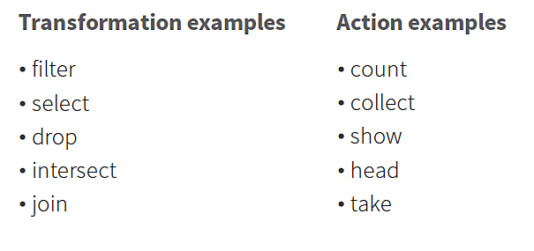
Examples
Transformations contribute to the query plan, but they don't execute anything
Actions cause the execution of the query

Slide 71
What can I do with a DataFrame?
Once you have a DataFrame, there are a number of operations you can perform
Let’s look at a few of them
But, first, let’s talk about columns
When we say “column” here, what do we mean?
A DataFrame column is an abstraction
It provides a common column-oriented view of the underlying data
Regardless of how the data is really organized

Slide 72
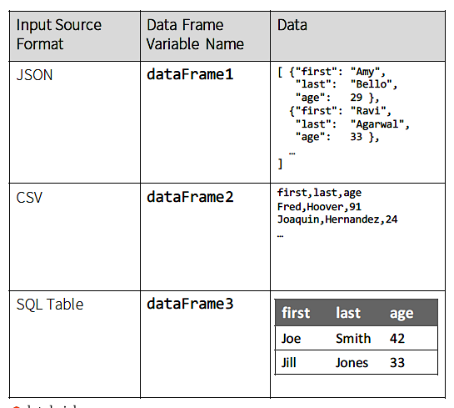
Columns
Let's see how
DataFrame
columns map
onto some
common data
sources

Slide 73
Columns

Slide 74
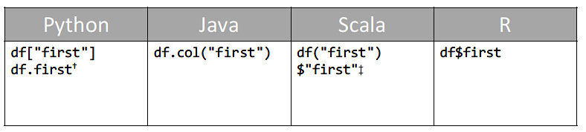
Columns
Assume we have a DataFrame, df, that reads a data source that has "first", "last", and "age" columns
In Python, it’s possible to access a DataFrame’s columns either by attribute (df.age) or by indexing (df['age’])
While the former is convenient for interactive data exploration, you should use the index form
It won’t break with column names that are also attributes on the DataFrame class.

Slide 75
DataFrame Operations Examples
Assume we have a file of age and name information (person.json) encoded in JSON format
Note, for Spark SQL a JSON record must occur on one line
{"name":"Michael"}
{"name":"Andy", "age":30}
{"name":"Justin", "age":19}

Slide 76
DataFrame Operations Examples: Create a DataFrame from a File
from pyspark.sql import SparkSession
spark = SparkSession(sc)
# Create the DataFrame
df = spark.read.json(“hdfs:///user/CSP554prof/people.json")
The read function of the SparkSession creates a DataFrameReader whose json() function loads the indicated file into a DataFrame
On loading the DataFrame schema is inferred from the input file

Slide 77
DataFrame Operations Examples: Show the Content of the DataFrame
You can look at the first n elements in a DataFrame with the show(n=20) method
If not specified, n defaults to 20
This method is an action
show()…
Reads the input source
Executes the RDD DAG across the cluster
Pulls the n elements back to the driver JVM
Displays those elements in a tabular form

Slide 78
DataFrame Operations Examples: Show the Content of the DataFrame
df.show()
Output
age name
null Michael
30 Andy
19 Justin

Slide 79
DataFrame Operations Examples: Print the Schema in a Tree Format
df.printSchema()
You can have Spark tell you what it thinks the data schema is, by calling the printSchema() method
Ouptut
root
|-- age: long (nullable = true)
|-- name: string (nullable = true)

Slide 80
DataFrame Operations collect()
The collect() action is used to retrieve all the elements of a DataFrame to the driver node
Use collect() on smaller dataset usually after filter(), group(), count() etc.
Retrieving larger dataset results in out of memory

Slide 81
DataFrame Operations collect()
dept = [("Finance",10), \
("Marketing",20), \
("Sales",30), \
("IT",40) \
]
deptColumns = ["dept_name","dept_id"]
deptDF = spark.createDataFrame(data=dept, schema = deptColumns)
deptDF.show(truncate=False)
+---------+-------+
|dept_name|dept_id|
+---------+-------+
|Finance |10 |
|Marketing|20 |
|Sales |30 |
|IT |40 |
+---------+-------+

Slide 82
DataFrame Operations collect()
dataCollect = deptDF.collect()
print(dataCollect)
deptDF.collect() retrieves all elements in a DataFrame as an array or Rows to the driver
Printing a resultant array yields below output:
[Row(dept_name='Finance', dept_id=10), Row(dept_name='Marketing', dept_id=20), Row(dept_name='Sales', dept_id=30),
Row(dept_name='IT', dept_id=40)]

Slide 83
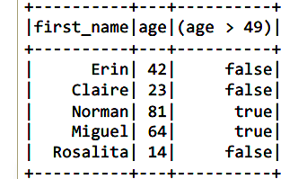
DataFrame Operations select()
select() is like a SQL SELECT, allowing you to limit the results to specific columns
df.select(df['first_name'], df['age'], df['age'] > 49).show(5)

Slide 84
DataFrame select(*cols)
Projects a set of expressions and returns a new DataFrame.
Parameters:
cols – list of column names (string) or expressions (Column). If one of the column names is ‘*’, that column is expanded to include all columns in the current DataFrame.
>>> df.select('*').collect()
[Row(age=2, name=u'Alice'), Row(age=5, name=u'Bob')]
>>> df.select('name', 'age').collect()
[Row(name=u'Alice', age=2), Row(name=u'Bob', age=5)]
>>> df.select(df.name, (df.age + 10).alias('age')).collect()
[Row(name=u'Alice', age=12), Row(name=u'Bob', age=15)]

Slide 85
DataFrame Operations Examples: Select Only the "name" Column
df.select(‘name’).show()
or
df.select(df.name).show()
or
df.select(df[‘name’]).show()
Output
name
Michael
Andy
Justin

Slide 86
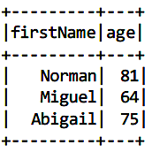
DataFrame Operations filter() or where()
The filter() method allows you to filter rows out of your results
where() is an alias for filter()
df.filter(df['age'] > 49).\
select(df['first_name'], df['age’]).show()
show()

Slide 87
DataFrame Operations Examples: Select People Older Than 21
df.filter(df['age'] > 21).show()
Output
age name
30 Andy

Slide 88
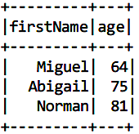
DataFrame Operations orderBy()
The orderBy() method allows you to sort the results
df.filter(df["age”] > 49). \
select(df["firstName”], df["age”]). \
orderBy(df["age”], df["firstName”]). \
show()

Slide 89
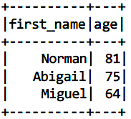
DataFrame Operations orderBy()
df.filter(df['age'] > 49).\
select(df['first_name'], df['age']).\
orderBy(df['age'].desc(), df['first_name']).show()
desc()
Returns a sort expression based on the descending order of the column
asc()
(default) Returns a sort expression based on ascending order of the column

Slide 90
DataFrame Operations withColumn()
Returns a new DataFrame by adding a column or replacing the existing column that has the same name
withColumn(colName, col)
colName – string, name of the new column
col – a column expression for the new column
df.withColumn('age2', df[‘age’] + 2)

Slide 91
DataFrame Operations withColumnRenamed()
Returns a new DataFrame by renaming an existing column
withColumnRenamed(existing, new)
existing – string, name of the existing column to rename
new – string, new name of the column
df.withColumnRenamed('age', 'age2')

Slide 92
DataFrame Operations cast()
cast(dataType)
Convert the column into type datatype
df.select(df.age.cast(StringType()).alias('ages'))

Slide 93
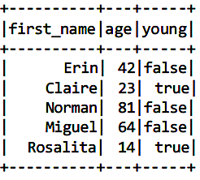
DataFrame Operations alias()
alias() allows you to rename a column
It’s especially useful with generated columns
df.select(df['first_name’], \
df['age’], \
(df['age'] < 30).alias('young')).show(5)

Slide 94
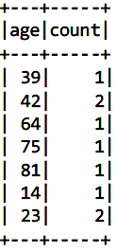
DataFrame Operations groupBy()
groupBy(cols)
Groups the DataFrame using the specified columns, so we can run aggregations, like count(), on them
cols – list of columns to group by. Each element should be a column name (string) or a column expression
groupBy() returns an instance of GroupData which offers a range of aggregation functions including count()
df.groupBy("age").count().show()

Slide 95
DataFrame Operations groupBy()
This example does a groupBy() on department column and calculates sum() and avg() of salary for each department and calculates sum() and max() of bonus for each department
df.groupBy("department") \
.agg(sum("salary").alias("sum_salary"), \
avg("salary").alias("avg_salary"), \
sum("bonus").alias("sum_bonus"), \
max("bonus").alias("max_bonus") \
) \
.show(truncate=False)
+----------+----------+-----------------+---------+---------+
|department|sum_salary|avg_salary |sum_bonus|max_bonus|
+----------+----------+-----------------+---------+---------+
|Sales |257000 |85666.66666666667|53000 |23000 |
|Finance |351000 |87750.0 |81000 |24000 |
|Marketing |171000 |85500.0 |39000 |21000 |
+----------+----------+-----------------+---------+---------+

Slide 96
Aggregation Functions
df.groupBy(…).someAggregationFunction(cols)
When we perform groupBy() on a Dataframe, it returns a GroupData instance which contains below aggregate functions:
count(*cols) - Returns the count of rows for each group.
mean(*cols) - Returns the mean of values for each group.
max(*cols) - Returns the maximum of values for each group.
min((*cols) - Returns the minimum of values for each group.
sum(*cols) - Returns the total for values for each group.
avg(*cols) - Returns the average for values for each group.
agg(*cols) - Using agg() function, we can calculate more than one aggregate at a time.

Slide 97
DataFrame describe(*cols)
Computes statistics for numeric columns.
This include count, mean, stddev, min, and max
If no columns are given, this function computes statistics for all numerical columns

Slide 98
DataFrame describe(*cols)
>>> df.describe().show()
+-------+------------------+
|summary| age|
+-------+------------------+
| count | 2|
| mean | 3.5|
| stddev | 2.1213203435596424|
| min| 2|
| max| 5|
+-------+------------------+
>>> df.describe(['age', 'name']).show()
+-------+------------------+-----+
|summary| age| name|
+-------+------------------+-----+
| count| 2| 2|
| mean| 3.5| null|
| stddev| 2.1213203435596424| null|
| min| 2|Alice|
| max| 5| Bob|
+-------+------------------+-----+

Slide 99
DataFrame distinct()
Returns a new DataFrame containing the distinct rows in this DataFrame
df.distinct().count()
2

Slide 100
DataFrame drop(col)
Returns a new DataFrame that drops the specified column
Parameters:
col – a string name of the column to drop, or a Column to drop.

Slide 101
DataFrame drop(*cols)
>>> df.drop('age').collect()
[Row(name=u'Alice'), Row(name=u'Bob')]
>>> df.drop(df.age).collect()
[Row(name=u'Alice'), Row(name=u'Bob')]
>>> df.join(df2, df.name == df2.name, 'inner').drop(df.name).collect()
[Row(age=5, height=85, name=u'Bob')]
>>> df.join(df2, df.name == df2.name, 'inner').drop(df2.name).collect()
[Row(age=5, name=u'Bob', height=85)]

Slide 102
DataFrame dropna(how='any', thresh=None, subset=None)
Returns a new DataFrame omitting rows with null values
Parameters:
how – ‘any’ or ‘all’. If ‘any’, drop a row if it contains any nulls. If ‘all’, drop a row only if all its values are null.
thresh – int, default None If specified, drop rows that have less than thresh non-null values. This overwrites the how parameter.
subset – optional list of column names to consider.
>>> df4.dropna().show()
+---+------+-----+
|age|height| name|
+---+------+-----+
| 10| 80|Alice|
+---+------+-----+

Slide 103
DataFrame dtypes
dtypes
Returns all column names and their data types as a list
>>> df.dtypes
[('age', 'int'), ('name', 'string')]

Slide 104
DataFrame fillna(value, subset=None)
Replace null values
Parameters:
value – int, long, float, string, or dict. Value to replace null values with. If the value is a dict, then subset is ignored and value must be a mapping from column name (string) to replacement value. The replacement value must be an int, long, float, or string.
subset – optional list of column names to consider
Columns specified in subset that do not have matching data type are ignored
For example, if value is a string, and subset contains a non-string column, then the non-string column is simply ignored.

Slide 105
DataFrame filter(condition)
Filters rows using the given condition.
Parameters:
condition – a Column of types.BooleanType or a string of SQL expression

Slide 106
DataFrame filter(condition)
>> df.filter(df.age > 3).collect()
[Row(age=5, name=u'Bob')]
>>> df.where(df.age == 2).collect()
[Row(age=2, name=u'Alice')]
>>> df.filter("age > 3").collect()
[Row(age=5, name=u'Bob')]
>>> df.where("age = 2").collect()
[Row(age=2, name=u'Alice')]

Slide 107
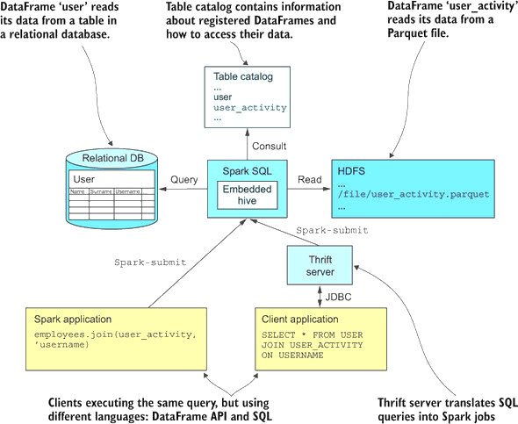

Slide 108
DataFrame first()
Returns the first row as a Row.
>>> df.first()
Row(age=2, name=u'Alice')

Slide 109
DastaFrame foreach()
Applies the f function to all Row of this DataFrame.
>>> def f(person):
... print(person.name)
>>> df.foreach(f)

Slide 110
DataFrame head(n=None)
Returns the first n rows.
Parameters
n – int, default 1. Number of rows to return.
Returns
If n is greater than 1, return a list of Row. If n is 1, return a single Row.
>>> df.head()
Row(age=2, name=u'Alice')
>>> df.head(1)
[Row(age=2, name=u'Alice')]

Slide 111
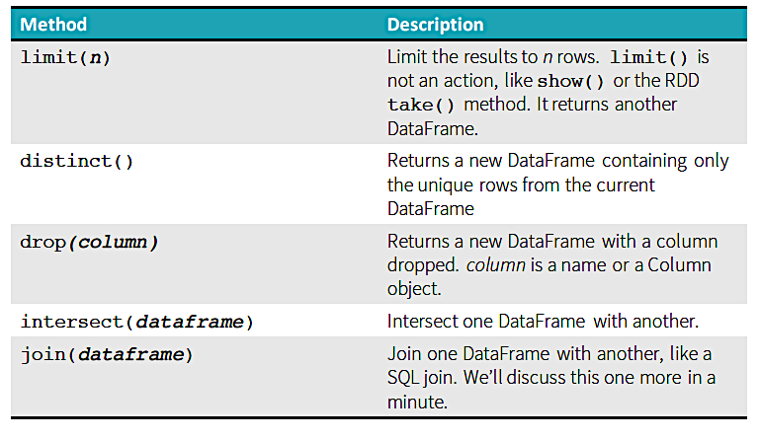
Other Useful Transformations

Slide 112
DataFrame join(other, on=None, how=None)
Joins with another DataFrame, using the given join expression.
Parameters:
other – Right side of the join
on – a string for join column name, a list of column names, a join expression (Column) or a list of Columns
If on is a string or a list of string indicating the name of the join column(s), the column(s) must exist on both sides, and this performs an inner equi-join.
how – str, default ‘inner’. One of inner, outer, left_outer, right_outer, leftsemi

Slide 113
DataFrame join(other, on=None, how=None)
.>>> df.join(df2, df.name == df2.name, 'outer').select(df.name, df2.height).collect()
[Row(name=None, height=80), Row(name=u'Alice', height=None), Row(name=u'Bob', height=85)]
>>> cond = [df.name == df3.name, df.age == df3.age]
>>> df.join(df3, cond, 'outer').select(df.name, df3.age).collect()
[Row(name=u'Bob', age=5), Row(name=u'Alice', age=2)]
>>> df.join(df2, 'name').select(df.name, df2.height).collect()
[Row(name=u'Bob', height=85)]
>>> df.join(df4, ['name', 'age']).select(df.name, df.age).collect()
[Row(name=u'Bob', age=5)]

Slide 114
Writing DataFrames
You can write DataFrames out, as well
When doing ETL, this is a very common requirement.
In most cases, if you can read a data format, you can write that data format, as well.
The core pattern for writing data is as follows:
spark.write.format(…).option(…).partitionBy(…).bucketBy(…).sortBy(…).save(…)
But we will generally usemo re compact forms:
df.write.option("header",True).csv("/tmp/spark_output/zipcodes")
df.write.format("json").save("/path/to/directory")

Slide 115
Writing DataFrames
The foundation for writing data is the DataFrameWriter
We access the DataFrameWriter on a per DataFrame basis as follows:
someDataFrame.write
Note, you do not specify the name of a file to which to write a DataFrame but a directory:
df.write.format("parquet").save("/path/to/directory")
If you're writing to a text file format (e.g., JSON, CSV), you’ll typically get multiple output files in that directory
Usually one per DataFrame partition

Slide 116
Writing DataFrames Write DataFrame to CSV file
Use the write() method of the DataFrameWriter object to write a DataFrame to a CSV file
While writing a CSV file you can use several options
Use “header” to output the DataFrame column names as a header record
Use ’sep’ to specify the delimiter on the CSV output file
df.write.option("header",True) \
.option(“sep”, ‘\t’) \
.csv("/tmp/spark_output/zipcodes")

Slide 117
Writing DataFrames Saving Modes
The DataFrameWriter also has a method mode() to specify saving mode.
overwrite – mode is used to overwrite the existing file.
append – To add the data to the existing file.
ignore – Ignores write operation when the file already exists.
error or errorIfExists – Throw and error if the file already exists. This is the default option.
df2.write.mode('overwrite').csv("/tmp/spark_output/zipcodes")
//you can also use this df2.write.format("csv").mode('overwrite').save("/tmp/spark_output/zipcodes")

